Slide 1
EDA analysis –Unbill
Data Dremer’s

Slide 2
Objective
Would like to predict who are going to repay the debt amount
Data Information:
Unbill consists of 35,375 records and 11 columns
Some of interesting facts are below:

Slide 3
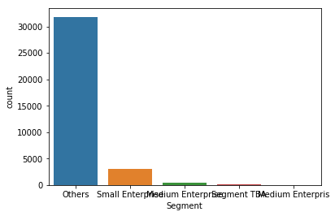
Univariate analysis
89% segment customers are “Others

Slide 4
Segment | Percentages
Others | 89.9
Small | 8.55
Med | 1.15
Segment TBA | 0.33

Slide 5
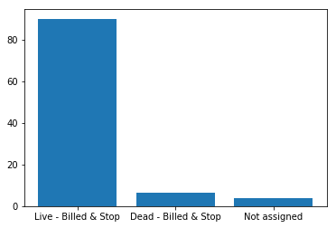

Slide 6
Site status analysis
Site Status | Percentages
Live | 90.03
dead | 6.36
notassigned | 3.6

Slide 7
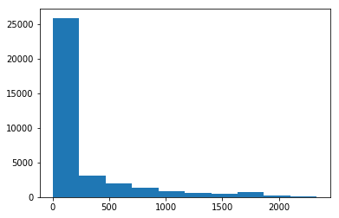
Insights for unbilled days
1. Average unbilled days customers are 317
2. Most of the customers are lying in between 1-137

Slide 8
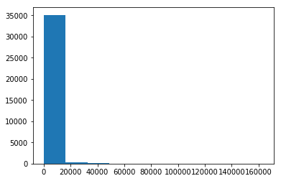

Slide 9
Billing_Class | Industrial & Commercial | Small and Medium Enterprises
M | 523 | 6416
Q | 0 | 28436
Total | 523 | 34852

Slide 10
Insights for Bi-Varaiate
1. Industrial and commercial customers are monthly billing frequency
2.98% of customers are quarterly billing frequency customers(Small and medium)
3. Industrial and commercial customers are having high value unbilled
4. 4.8% of the customers are having non paying customer at over all view
5. 73% of non paying customers are quarterly customers

